Slide 1
Analysis of single-cell RNA-seq data (II)
Hao Wu
Department of Biostatistics and Bioinformatics
Rollins School of Public Health
Emory University
Ziyi Li
Department of Biostatistics
The University of Texas MD Anderson Cancer Center
ENAR 2021 short course
March 2021

Slide 2
Course outline
8-9:15: Intro and data preprocessing.
9:15-9:45: Lab: preprocessing and visualization.
10-11:15: Normalization, batch effect, imputation, DE, simulator.
11:15-12: Lab: Normalization, batch effect, imputation, DE, simulator
12-1: lunch break
1-2: Clustering and pseudotime construction
2-2:30: Lab: Clustering and pseudotime construction
2:45–3:30: Supervised cell typing & related single cell data sources
3:30-4: Lab: supervised cell typing.
4:15-5: scRNA-seq in cancer

Slide 3
Outline for this session
Statistical models for scRNA-seq data
Data preprocessing
Normalization
Batch effect correction
Imputation
Differential expression
Data simulator
Sample size calculator

Slide 4
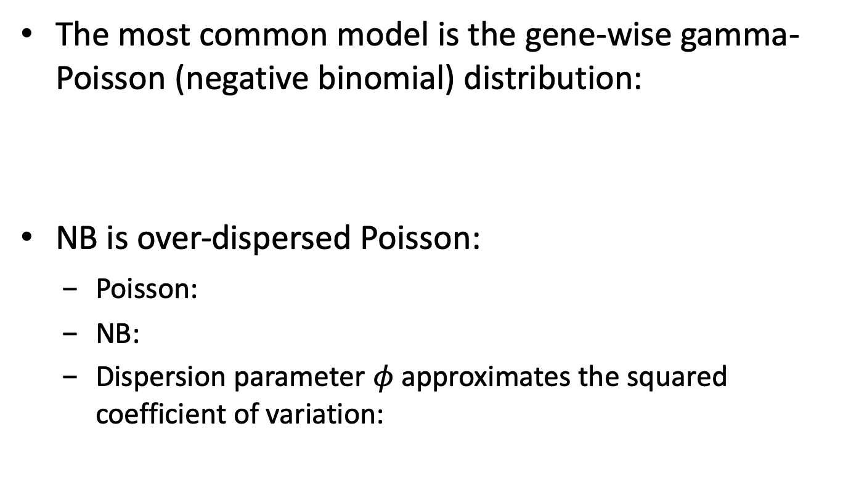
Review: data model for bulk RNA-seq
The most common model is the gene-wise gamma-Poisson (negative binomial) distribution:
NB is over-dispersed Poisson:
Poisson:
NB:
Dispersion parameter $φ$ approximates the squared coefficient of variation:

Slide 5
Data model for scRNA-seq
The data distribution is more complex than bulk RNA-seq due to
Mixture of cell types
Drop out
Often-used statistical models
Gene-wise: zero-inflated model, mixture model
Cell-wise: Dirichlet-multinomial.

Slide 6
Gene-wise modeling
Many expressions follow multi-modal distribution.
Most methods use mixture of distributions:
SCDE (Kharchenko et al., 2014): a mixture of NB and Poisson.
MAST (Finak et al., 2015): a generalized linear hurdle model.
SC2P (Wu et al. 2018): a mixture of zero-inflated Poisson (ZIP) and lognormal-Poisson.
Some recent discussion about the presence of zero-inflation: whether it’s caused by UMI or droplet.
Cao et al. 2020 Nat Biotech; Svensson 2020 Nat Biotech.

Slide 7
Cell-wise modeling
Counts for cells in one cell type follow Dirichlet-multinomial distribution
Counts for each cell follow a multinomial distribution
The MN means follow Dirichlet cross cells.
For multiple cell types, the counts follow a mixture of Dirichlet-multinomial.
Used more often in cell clustering methods (DIMM-SC, BAMM-SC).

Slide 8
Data normalization
scRNA-seq is very noisy.
Spike-in data is usually available.
Spike-ins from the external RNA Control Consortium (ERCC) panel contains 92 synthetic spikes based on bacterial genome with known expression level.
UMI is helpful for removing amplification noise.
A combination of spike-in and UMI can potentially be used for data normalization.
Simple normalization (such as by sequencing depth) for bulk RNA-seq can be applied, e.g., TPM or FPKM.

Slide 9
Works for data without spike-in.
The goal is to estimate a size factor for each cell.
The idea is to normalize on summed expression values from pools of cells – it’s more stable than using individual cell.
Bioconductor package scran.

Slide 11
Basic idea: one normalization factor per cell doesn’t fit all genes.
Relationships of read counts and sequencing depths vary and depend on the expression levels.

Slide 13
SCnorm Solution
Uses quantile regression to estimate the dependence of read counts on sequencing depth for every gene.
Genes with similar dependence are then grouped, and a second quantile regression is used to estimate scale factors within each group.
Bioconductor package SCnorm.

Slide 14
Batch effect
Batch effect in scRNA-seq can be severe.
Can be difficult to randomize the design, i.e., batch is confounded with individual, so it causes trouble for analyzing data from multiple individuals (more on this later).
Bulk data method such as Combat doesn’t work well.

Slide 15
Batch effect correction methods
The cells are from different cell types, which complicates the problem.
Most methods are developed for cell clustering, i.e., jointly perform batch correction and cell clustering.
The goal is to minimize the impact of batch effects on cell clustering.

Slide 18
A comprehensive comparison paper

Slide 21
Other interesting methods

Slide 22
Data imputation
scRNA-seq has lots of missing data (dropout).
Imputing the missing data help the downstream analyses.
There are a number of methods:
SAVER (Huang et al. 2018 Nat. Methods)
ScImpute (Li et al. 2018 Nat. Comm.)
MAGIC (van Dijk et al. 2018 Cell)
SCRABBLE (Peng et al. 2019 GB)

Slide 23
General strategy for imputation
The problem is similar to a “recommendation system”.
First compute the similarities among genes and cells.
To impute one element, borrow information from similar gene/cell.

Slide 24
MAGIC

Slide 25
scImpute: base on Gamma-Normal mixture model to estimate and impute dropout values.
Steps:
Learn each gene’s dropout probability in each cell
Impute dropout values of genes in a cell by borrowing information of the same gene in other “similar” cells, which are selected based on genes not severely affected by dropout events.

Slide 26
Use gene-to-gene relationships to recover the true expression levels.
Assume gamma-Poisson (NB) for counts
Estimate the gamma prior parameters in an empirical Bayes-like approach with a Poisson LASSO regression, using the expression of other genes as predictor.
The posterior mean are the imputed expression.

Slide 27
SAVER model

Slide 29
Differential expression (DE)
DE analysis is the most important task for bulk expression data (microarray or RNA-seq).
Popular tools:
Microarray: limma
Bulk RNA-seq: DESeq2, edgeR
Important method:
Variance shrinkage

Slide 30
DE in scRNA-seq
Considering cell types:
Compare cross cell types: identify cell type specific genes.
Compare the same cell type cross biological conditions.
Need cell clustering first.
Method consideration:
Traditional methods test mean changes
The consideration and modeling of “drop-out” is important in scRNA-seq data.

Slide 31
DE methods
SCDE (Kharchenko et al. 2014 Nat. Methods)
MAST (Finik et al. 2015 GB)
SC2P (Wu et al. 2018 Bioinformatics)
Seurat and monocle provide DE functions.
Bulk methods (DESeq, edgeR) are sometimes used.
A comparison paper: Soneson and Robinson (2018) Nat. Methods

Slide 32
MAST: “Model-based Analysis of Single- cell Transcriptomics.”
Bioconductor package MAST.

Slide 33
MAST for DE
Main ideas:
Use log2(TPM+1) as input data
Both dropout probability and expression level depends on experimental conditions.
Model fitting with some regularization.
DE is based on chi-square or Wald test.

Slide 34
Example codes for MAST
Start from log TPM and biological condition
sca <- FromMatrix(ltpm,
cData=data.frame(celltype))
cdr2 <- colSums(assay(sca)>0)
colData(sca)$cngeneson <- scale(cdr2)
thres <- thresholdSCRNACountMatrix(assay(sca),
nbins=200, min_per_bin=30)
assays(sca) <- list(thresh=thres$counts_threshold,
tpm=assay(sca))
## fit model and perform test
fit <- zlm(~celltype, sca)
lrt <- lrTest(fit, "celltype")

Slide 35
Soneson and Robinson (2018) Nat. Methods

Slide 36
scRNA-seq Data simulators
Method | Model Assumption | Reference
powsimR | NB (ZI-NB optional) on counts for both RNA-seq and scRNA-seq | Vieth et al., 2017, Bioinfo
scDesign | Gamma-normal mixture on log counts (same as scImpute) | Li et al., 2019, Bioinfo
Splatter (splat) | Gamma-Poisson hierarchical model on normalized counts (fitdistrplus) | Zappia et al., 2017, GB
POWSC | ZIP-LNP mixture on log normalized counts | Su et al., 2020, Bioinfo
scDBM | Deep generative models (Boltzmann Machines to the NB distribution) | Treppner et al., 2020, Preprint
scPOWER | NB on gene-level counts (DESeq) | Schmid et al., 2020, Preprint

Slide 37
Comparisons
Based on real data.
Estimate model parameters.
Simulate the data.
Compare between simulated and real expression matrices.
4 gene-wise parameters
2 cell-wise parameters.

Slide 38
Sample size calculation
Power evaluation and sample size calculation is an important consideration at the experimental design stage, and required by almost all grant applications.
Determining scRNA-seq sample size (# of cells) is difficult, i.e., no closed form solution.
A few methods available under the context of DE, rely on some simulation procedures.
Report number of cells required in order to achieve certain power for DE detection.

Slide 39
Power evaluator (in the context of DE analysis)
Method | Approach | Notes
powsimR | Use a series of established tools: edgeR, limma, and DESeq2. MAST, BPSC, and scDD | Report stratified power by mean expression levels
scDesign | Top 1000 genes ranked by effect score as reference true DE genes | Precision, recall, F1 score, and etc.
POWSC | Use MAST or SC2P to report two forms of DE genes | Stratified, marginal, and overall power evaluation
scPOWER | Use Mkmisc package for DE genes and use F test for eQTLs | Overall power by considering both power from DE genes and eQTLs

